Slide 1
Build intelligent apps with WinUI, Phi Silica and the Windows Copilot Runtime
Alvin Ashcraft
Sr. Content Developer - Microsoft

Slide 2
About Me
Software industry for nearly 30 years
Morning Dew link blog
Three books for Packt Publishing
Content developer at Microsoft since 2022
TechBash dev conference organizer since 2016
Notes:
A little background about me…
For those who don’t know me, I’ve been in the software industry since 1995, with most of that time (over 25) years spent as a developer and architect using various Microsoft technologies.
Some of you may also be familiar with my blog, the Morning Dew, where I’ve been posting daily links for .NET developers since 2007.
I also have three books from Packt Publishing. You can check those out on Packt’s website or on Amazon. Just search for my name.
Writing those books led me to pivot my career to technical writing. I joined Microsoft two years ago as a content developer. I write documentation, training modules, and code samples on Microsoft Learn. I work on the Windows developer docs team, helping to maintain the docs for client apps and APIs. I have another talk I give about my work as a content developer and how anyone can contribute to content on Learn through GitHub issues and PRs.
Finally, I’m one of the founding organizers of the TechBash developer conference. We’ve been running the event in the Poconos since 2016.

Slide 3

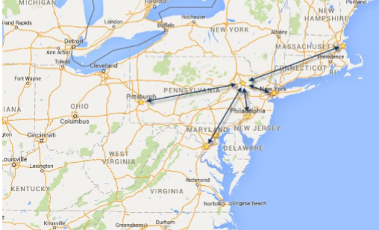

November 4-7, 2025 | Pocono Manor, PA
Great speakers with top content
A fraction of the cost of the more crowded conferences
- 3-day conference plus lodging for less than $1500
Full-day deep dive preconference sessions available
Easy travel from almost anywhere
World-class keynotes
In addition to the sessions, you get a great hallway
Track, amazing food, attendee Welcome Reception, Game Night & more
Family Day Friday - full day of kids' sessions, free for attendees' families
Discounted Kalahari Resort rooms with water park access: stay, learn & play all week
https://techbash.com or @techbash

Slide 4

Join Me at VSLive! @ MicrosoftHQ
Use code “Ashcraft” to save $400 on 4-day or 5-day packages
Aug 4-8 at Redmond Campus
https://vslive.com/microsofthq

Slide 5
Agenda
AI Options for .NET Developers
WinUI and Windows App SDK
Copilot+ PCs and Phi Silica
The Phil Silica APIs in Windows App SDK
Text Recognition APIs
Recall in Windows – Where does my app tie in?
The AI Dev Gallery app for Windows
Q&A

